Slide 1
Neural Control of Human Movement Journal Club
Date

Slide 2
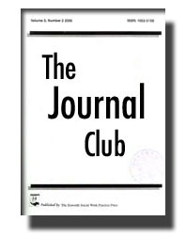
NCM Journal Club
Purpose:
Learn how to read and critique scientific papers
Maintain awareness of new research findings
Learn from other scientists’ interpretations of research findings
Develop connections and collaborations
Generate new ideas

Slide 3
NCM Journal Club
Guidelines:
Respectful and inclusive environment
Allow everyone to have a voice
Paper selection
Recent (last 5 years) or seminal
In field of NCM (basic to clinical)
No reviews
Presentations ≤ 20 minutes
Highlight figures and tables
Include potential discussion points

Slide 4
Today’s Paper

Slide 5
Context

Slide 6
Background

Slide 7
Rationale and Aim

Slide 8
Methods overview

Slide 9
Methods

Slide 10
Methods

Slide 11
Methods

Slide 12
Methods

Slide 13
Results

Slide 14
Results

Slide 15
Discussion

Slide 16
Discussion

Slide 17
Considerations

Slide 18
Thanks for coming!
Next one on ________

